Slide 1
Innovation lab
ELECTRICAL VEHICLE ROUTING
Name : Aman Gupta

Slide 2
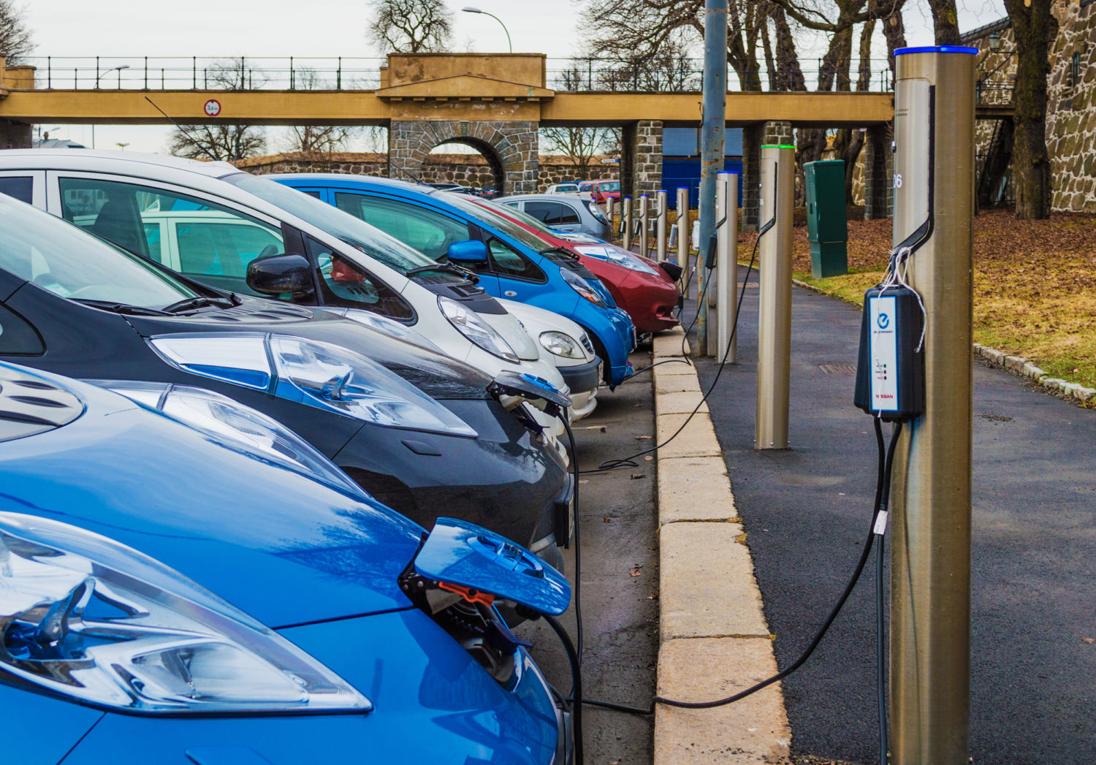

Why we need different routing systems for ev ?
Time for charging an EV is much more than fueling our conventional vehicle.

Slide 3
Why we need different routing systems for ev ?
Capacity of EV is not as much as conventional vehicle.
Capacity of EV is around 100-150KM for car, where as for scooters it is as low as 40-50KM.
Convention vehicles can easily cover distances of 1000KM-15000KM.

Slide 4
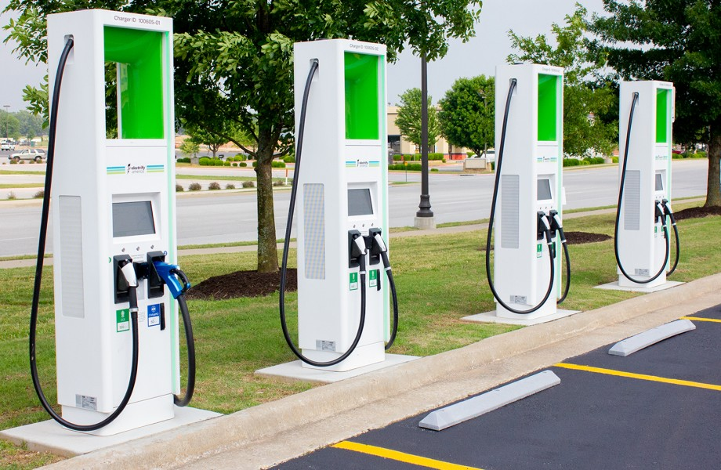
What are the solutions ?
We have to find the route such that we consider the initial charge which our EV has, in case it can move to final destination then routing will be same as conventional vehicle, but if it cannot move to final destination in initial charge then we will have to find the optimal station for it charging.
For optimal charging station we take factors in account such as waiting time and location of charging station.

Slide 5
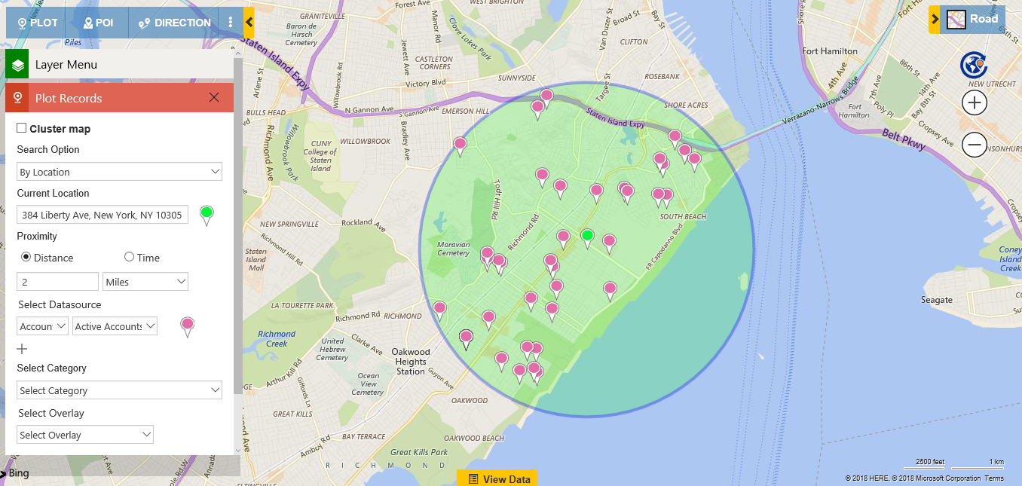
1st Input to the model.
In order to get the location person will have enter the details of his/her city such as coordinate of center and radius.

Slide 6
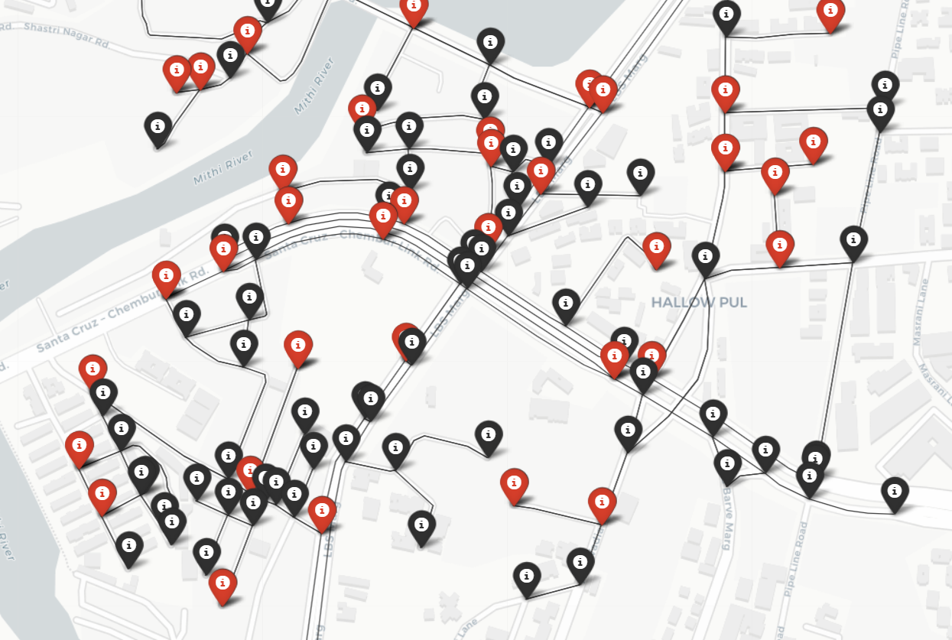
After 1st input.
After providing details it will generate the graph of city, for demo purpose it will generate 50 EV charging station which are going to spread randomly within the city. Along with this it will also give random waiting time to each EV charging station.
Here red nodes are EV charging station.

Slide 7
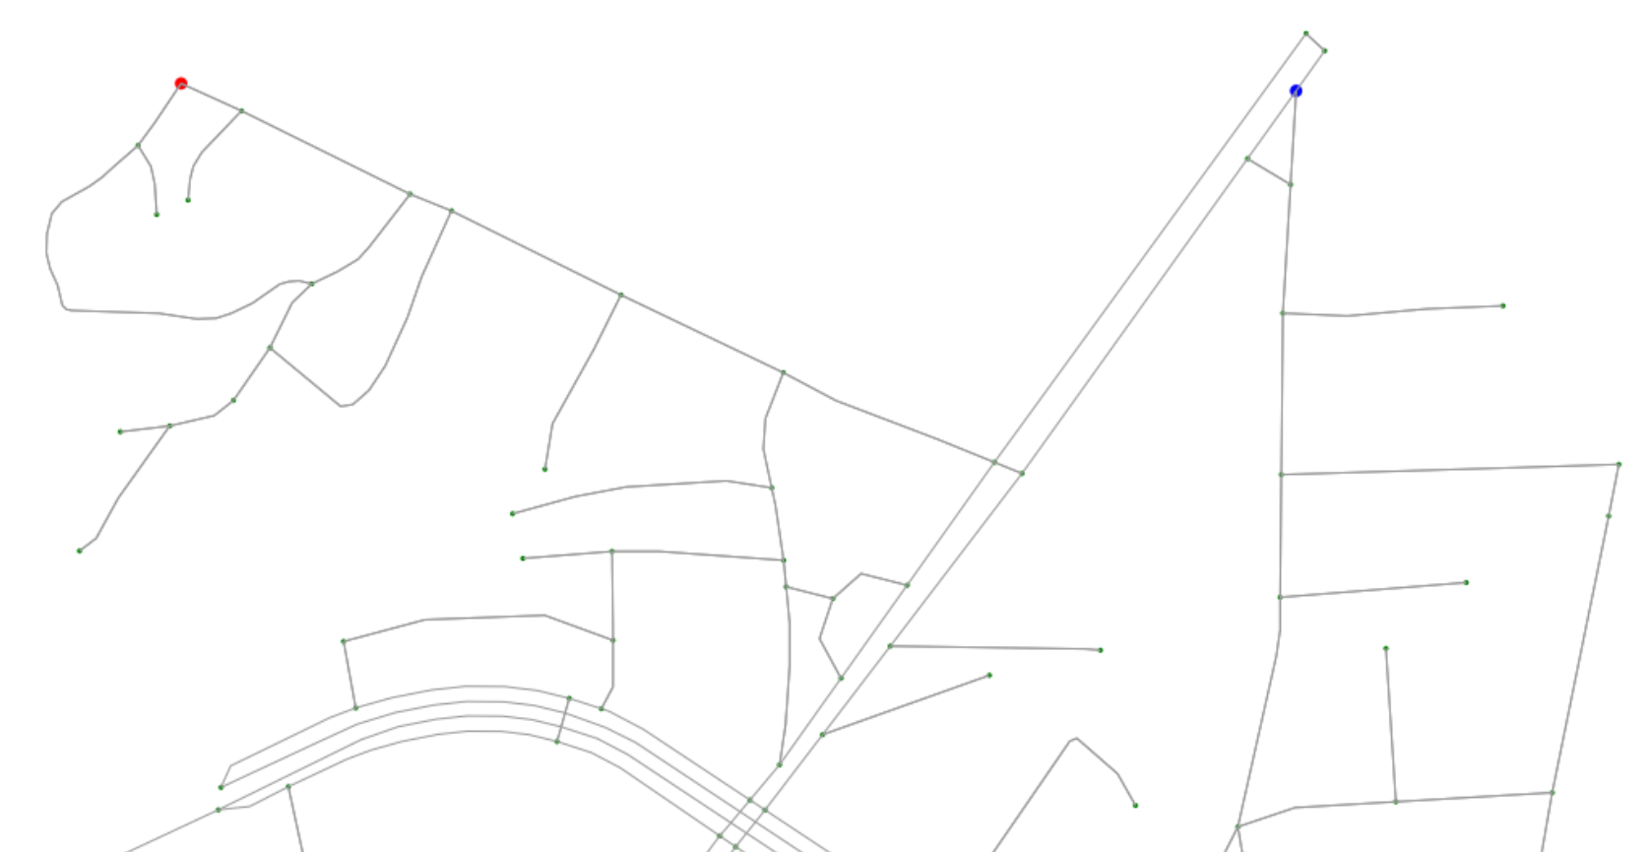
Now 2nd input
Now user needs to provide node number from where he/she want to travel and to where.
Along with this person can also provide details of the node which are not available at the time of travel.
In image red node is starting point and blue is the end point of journey.

Slide 8
Now after running the algorithm.

Slide 9
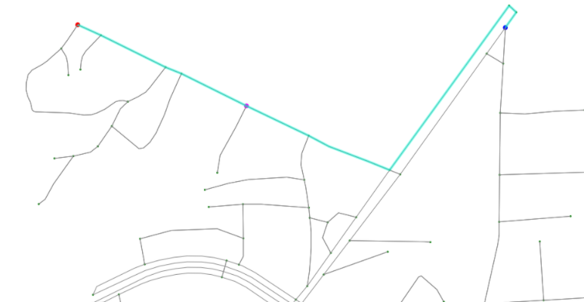
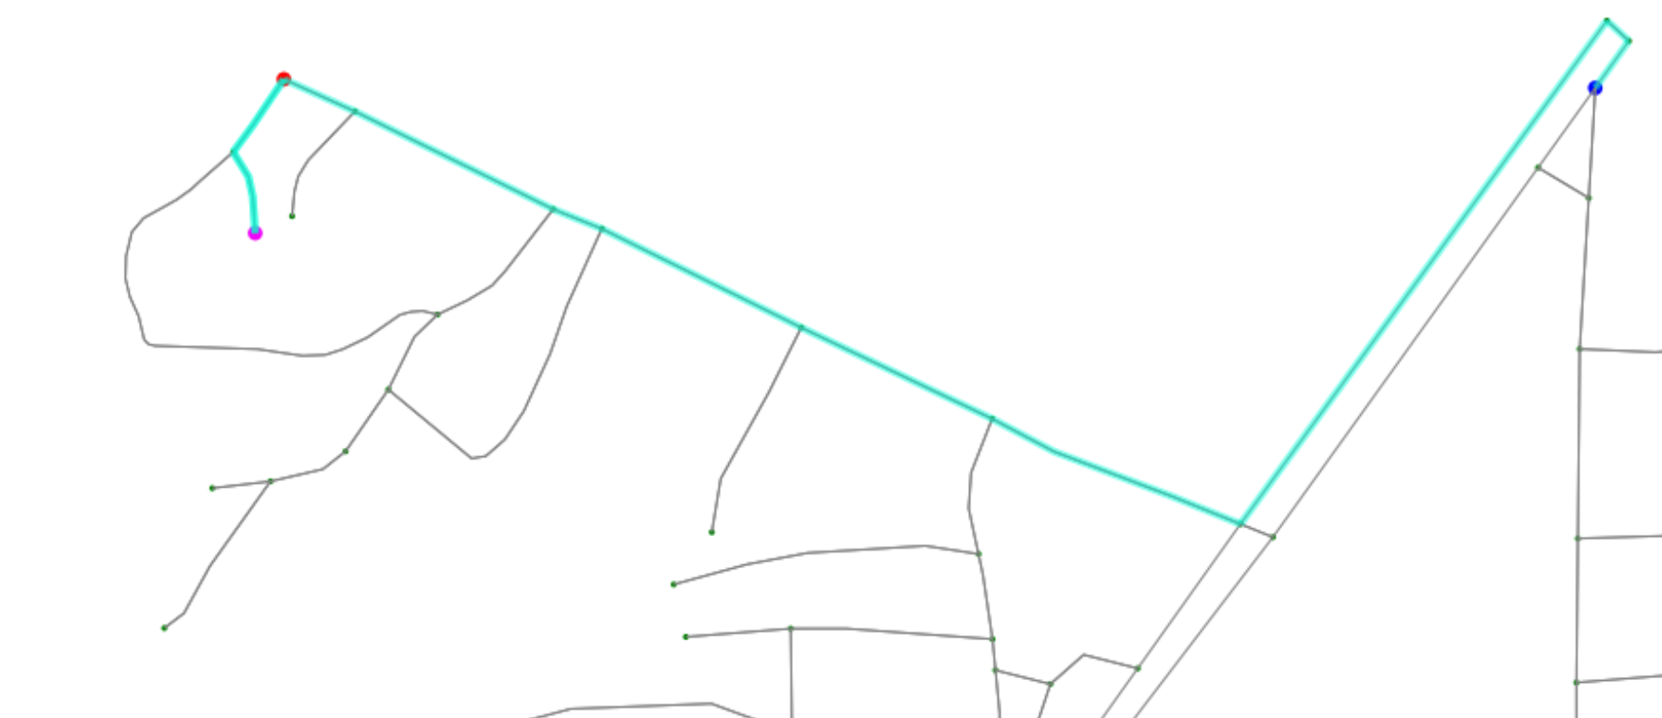
Algorithm will provide user with two routes.
1st route is based on least possible distance which person will have to travel in order to complete the journey.
Where as 2nd one is based on least possible time in which person can complete the journey.
Pink node represents charging station.

Slide 10
Now with the help of folium displaying routes In web.

Slide 11
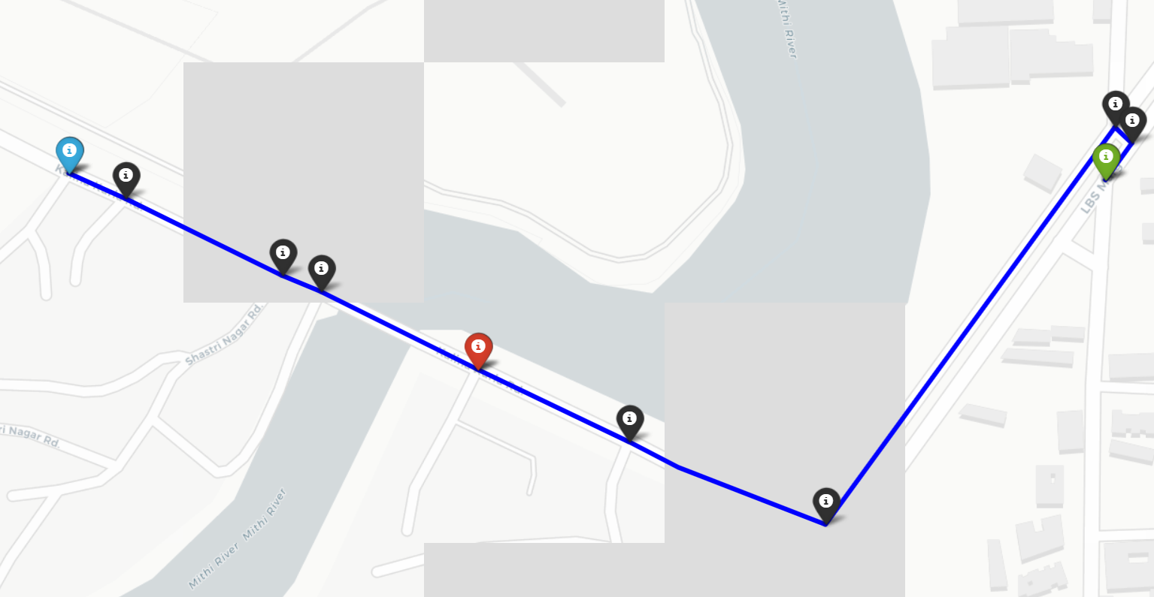

Slide 12
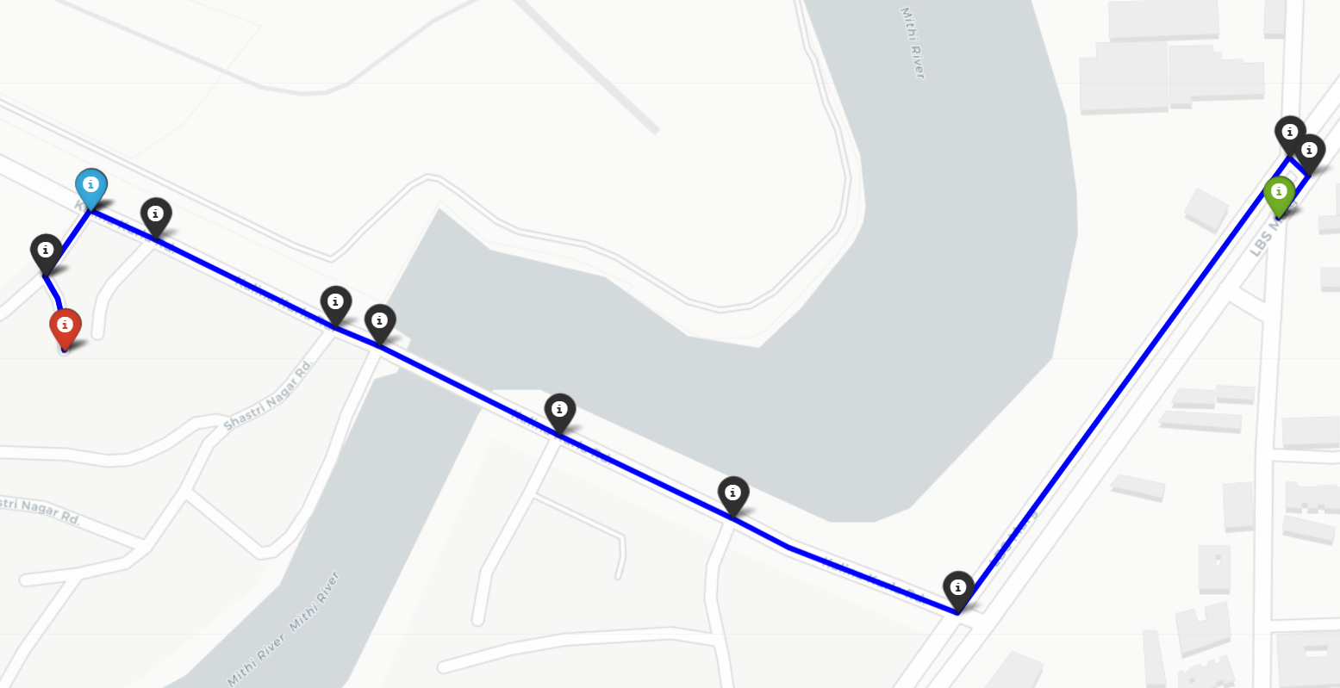

Slide 13
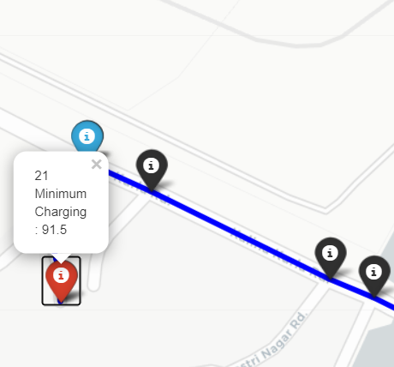

Slide 14
